Slide 1
Final Project
By: Paula Buitrago

Slide 2
Do NO₂ levels differ significantly between the Upper West Side and Queens Village in NYC?
Notes:
Since there is a categorical and a quantitative variable, I will be doing a difference in means hypothesis test

Slide 3
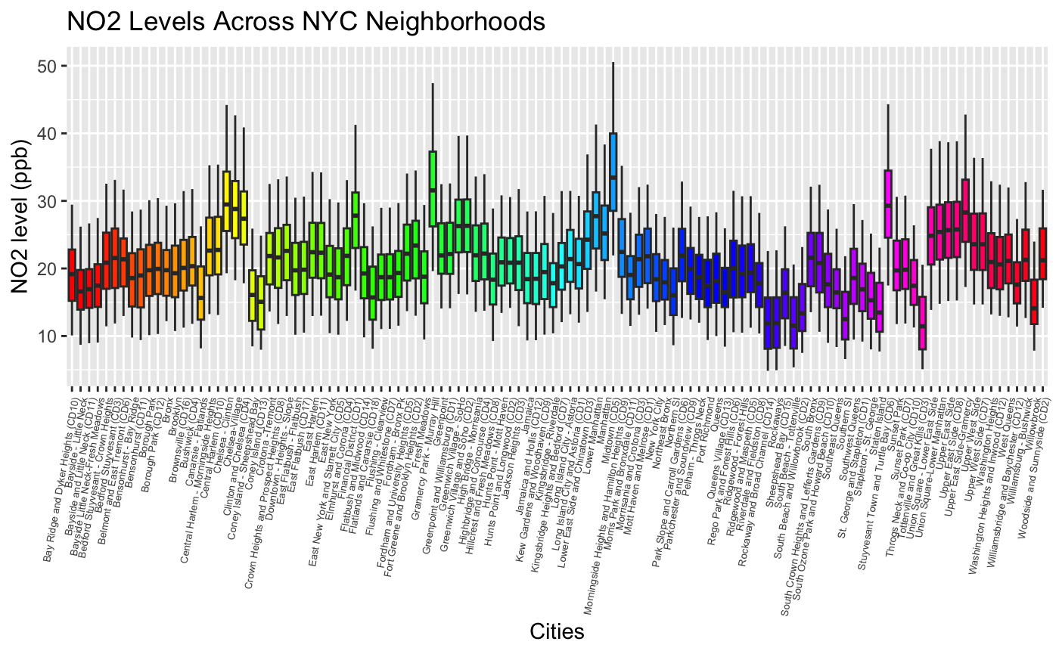
Notes:
- My dataset is about the air quality in NYC from 2009-2023
- my data is from data.gov
some of the Cities with the highest NO2 levels:
Central Harlem
Gramercy Park
Manhattan

Slide 4
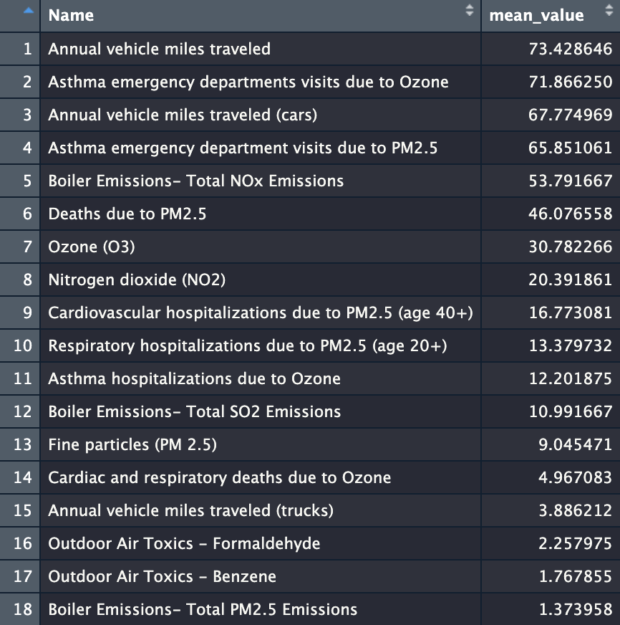
Statistical Analysis:
Notes:
When I cleaned up my data, I grouped the “name” column and noticed that the dataset also had information about health effects of pollutants which was interesting to look at
I also summarized the mean values of each observation, and I arranged them in descending order to see which ones were higher and lower
After looking at the table, I decided to focus on NO2 levels specifically in the upper west side of Manhattan and queens village
After this, I filtered the NO2 values for both neighborhoods and I used this data to run the t test

Slide 5
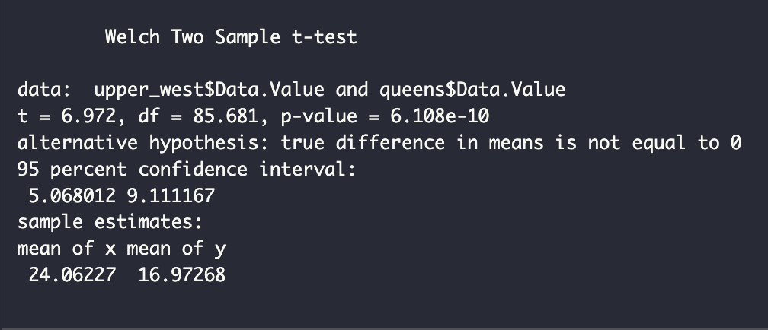
Results:
Notes:
- The Welch two sample t-test showed a p-value of 6.108e-10 which is less than 0.05, this means that there is enough statistical evidence that the NO2 levels in the upper west side and queen village differ significantly
- This could be due to a higher traffic density, building density, and maybe the use of residual oil boilers in the upper west side of Manhattan, which makes sense
- Queens village is still part of the city but they don’t have as much buildings or traffic on a daily basis, which results in lower NO2 levels

Slide 6
Obstacles:
Adjusting the box plot’s dimensions to fit all the city names.
Debugging syntax errors in the data analysis process.
Future steps:
Analyze seasonal or annual trends in NO₂ levels.
Compare NO₂ levels before and after COVID lockdowns.
Incorporating data on traffic patterns, building emissions, and weather data.
Notes:
Obstacles:
The city names were not fitting on the graph, so I had to do some research on how to change the angle of the names and add it to my code

